Slide 1

UM-2: ENTERTAINER DATA ANALYTICS

Slide 2
OBJECTIVES
Find youngest Male and Female Entertainer at the time of Breakthrough
Which year has the most breakthroughs
Gender distribution of alive Entertainers
Entertainers with longest and shortest active years

Slide 3
THE PROCESS
Data Collection
Data Cleaning
Data Analysis
Insights

Slide 4
DATA COLLECTION
The Data has been collected in the form of three xlsx files
The files contains the information about famous Entertainers/Artists

Slide 5
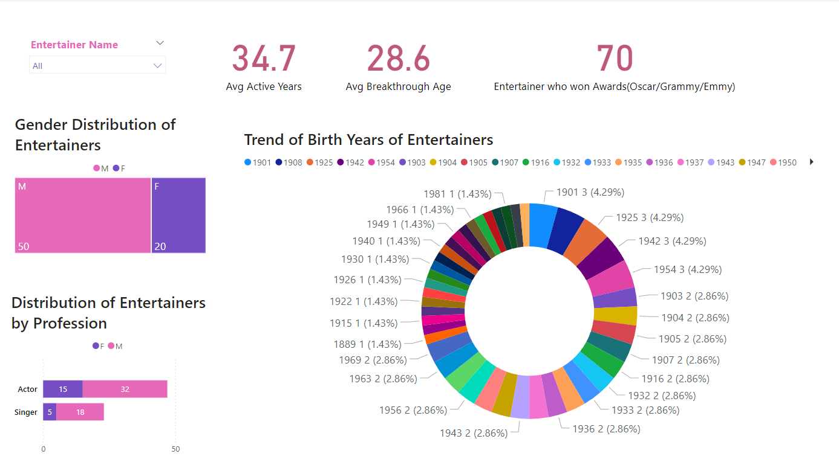
MY DESIGN

Slide 6
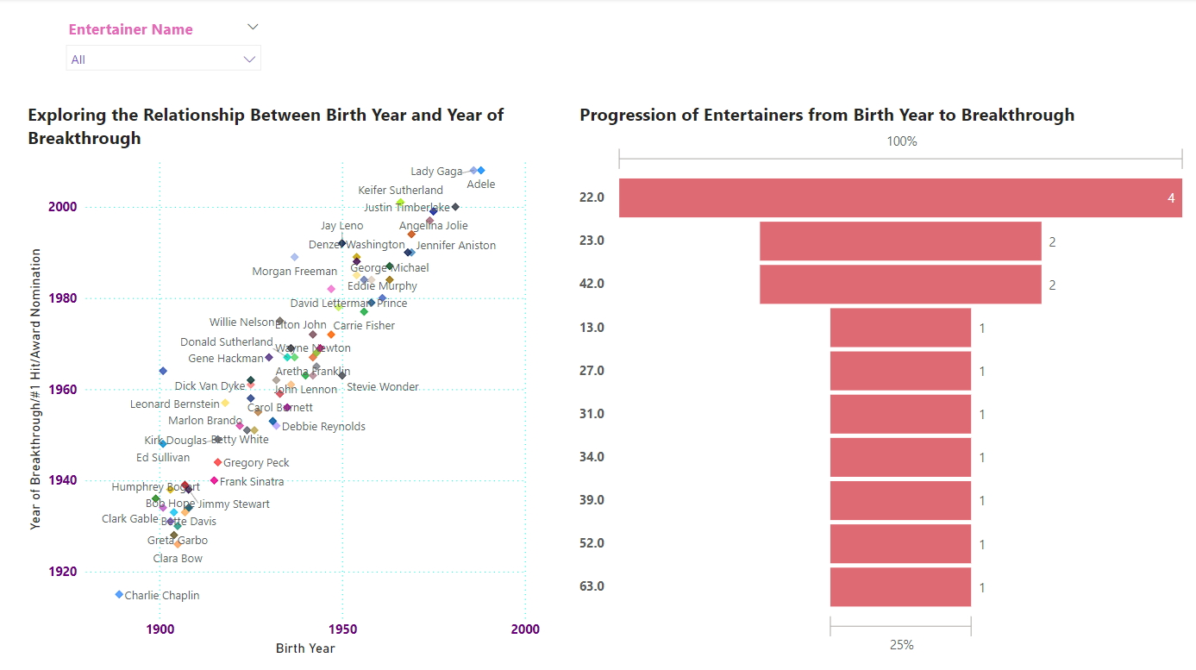

Slide 7
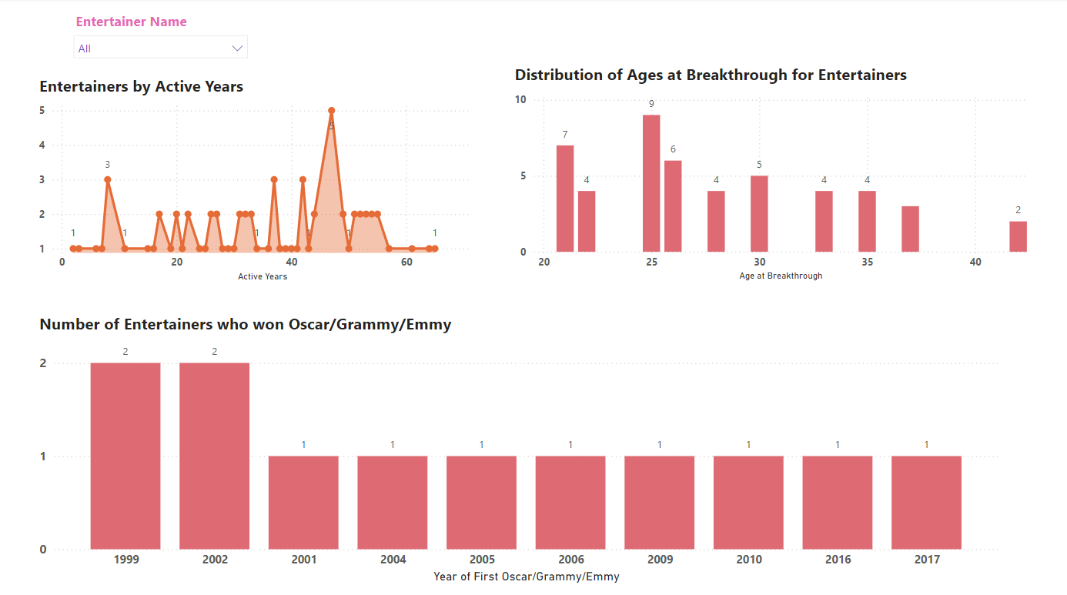

Slide 8
THANKYOU!!

